Slide 1

Wanderlust

Slide 2




Team
The Creators of WANDERLUST
Product and Strategy
Architecture
Product and Strategy
Mock-ups
Nicolas Urbach
Dennis
Mayer
Lukas Oldach
Alexander Kopp
“I don’t plan, I use WANDERLUST.”
“New route, new challenge.”
“WANDERLUST is my weekends favorite.”
“My favorite feature: follow the tips and enjoy the breaks.”

Slide 3
Business Model Canvas
Key Partners | Key Activities | Value Propositions |  | Customer Relationships | Customer Segments
 | Key Resources |  |  | Channels
Cost Structure |  |  | Revenue Streams
Technical infrastructure (IT Backend and real world)
Maintenance of beacons
Tourism organization
Restaurants
Providing push service for hiking tracks
Maintaining the management platform
Development of platform
Content quality assurance
Professional hiking experience without planning and without spending money on expensive maps / guides
Live information on points of interest along the track
Special offers during the trip
Alternative tracks
No navigation but focus on nature and hiking without following a route on the phone / map
Automated customer relationship to hiker
Personal and automated relationship through management platform
Spontaneous hiker
Local tourism organization
Region
Point of Interest
Restaurants along the hiking
Beacons
Web Services
Management Platform for Beacons and Content
Infrastructure (IT Backend)
Beacons
Web front end management platform
Webservice for hiker
Beacons
IT Infrastructure
Development
Support & Maintenance
Agency service for the preparation of hiking routes
Packaged offers for beacons on hiking trails based on the numbers of Reseller of beacons and consulting

Slide 4
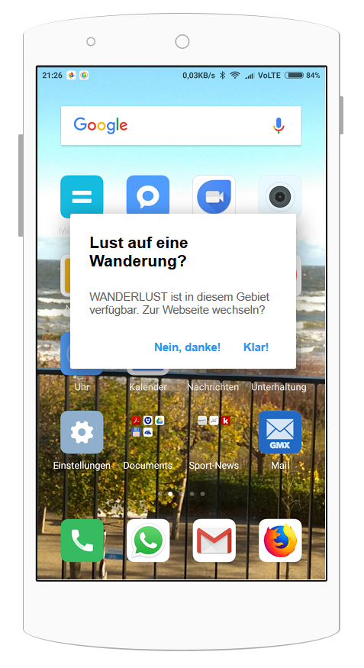



IoT Architecture of WANDERLUST
2
3
Beacon DB
1
5
4
Content DB
Beacon
Smartphone / Browser
Server

Slide 5

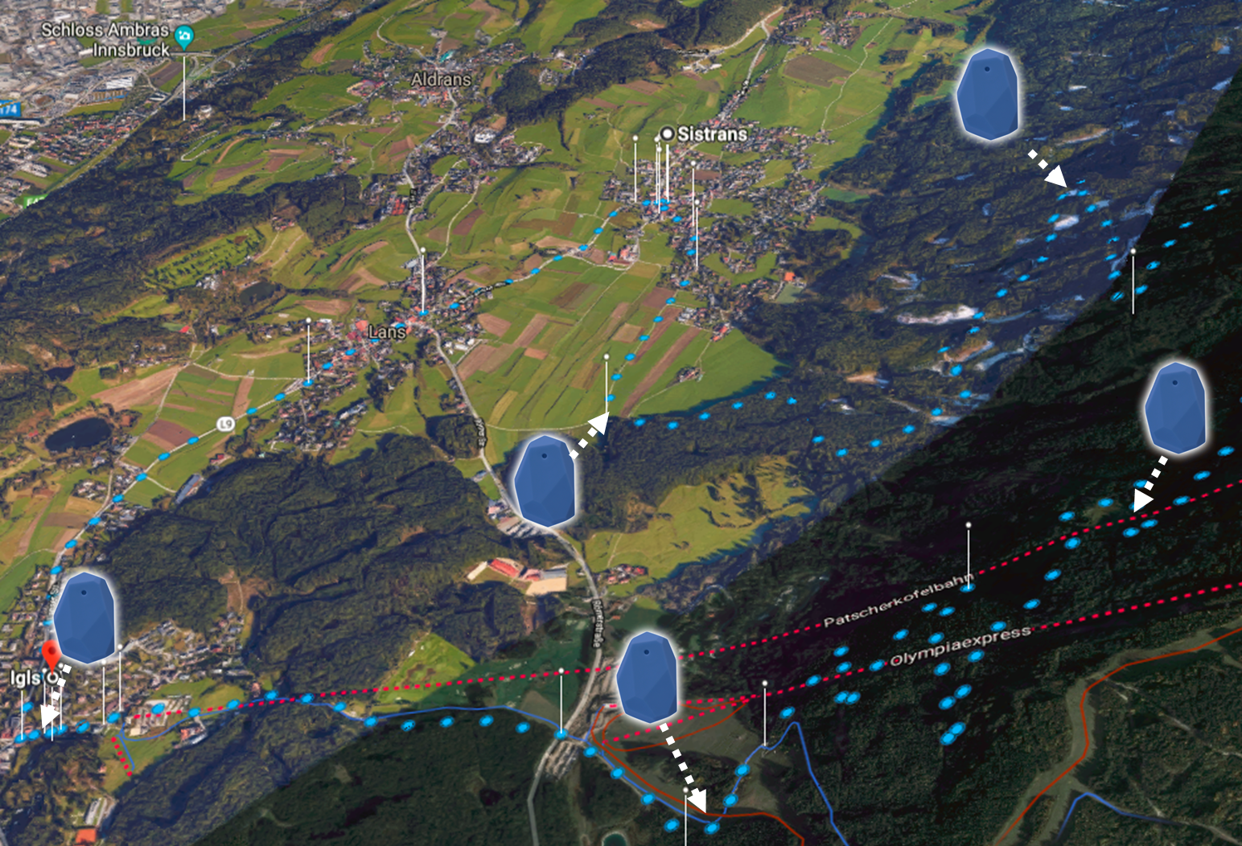

MVP - Route
Hiking as a Service
Share the experience via social media after the hike
info push
(URL)
Receive the info push from the Beacon
Set your personal preferences. Length, view points and break point for lunch.
Register in the trail for additional rescue service
Hiking tour part three: End
Smartphone
Cloud
Browse to the recommended hiking trail
Hiking tour part two: Lunch break
Selection of the hiking trail
Receive location based information (e.g. restaurant recommendation, special offers)
Start hiking the route from the car park
Have a break
Hiking tour part one: Start
Guided tour through the trail
Receive location based environmental information (e.g. landslide with alternative route)
Receive location based information (e.g. best view, environment)
Beacon
Each beacon is represented by an URL

Slide 6
Rethink MVP & technology usage
Change Beacon technology from single BLE 4.0 communication to LTE/BLE 4.0 communication
BeWhere M-IOT Beacons enable wide distance information update on beacons via LTE
Communication to user smartphone is still based on BLE 4.0
Reduced maintenance/update effort for beacons
Add WANDERLUST symbol and explanation on starting point of the covered hiking tracks
→ Reduce confusion after first popup from Beacon that the WANDERLUST service is available

